Slide 1

Ho Chi Minh City University of Transport
Image Processing and Computer Vision
Mode Finding & Mean-Shift
Tran Le Anh
anhtl@ut.edu.vn
04-2025

Slide 2
Mean-Shift
K-Means

Slide 3
Mean-Shift
K-Means

Slide 4
Mean-Shift
Mode Finding
- Mode finding, in statistics, is the process of identifying the most frequently occurring value (or values) within a dataset.
- In computer vision, mode finding refers to the process of identifying the most frequent or highest density areas within a dataset, often used for image segmentation and clustering.

Slide 5
Mean-Shift
Mean-Shift
- Mean-shift is a non-parametric mode-seeking algorithm used in computer vision and image processing for clustering, object tracking, and image segmentation.
- Mean-shift works by iteratively shifting data points towards the modes (or peaks) of a data distribution, effectively finding the regions of highest density.
Ref: https://ml-explained.com/blog/mean-shift-explained

Slide 6
Mean-Shift
Process
- Initialization: Start by considering each data point as a potential candidate for the cluster center.
- Density Estimation: For each data point, define a window around it, called the radius, and then compute the mean of those data points within this radius.
- Shifting: Shift each point to this mean position. This step moves the point towards the region of higher density.
- Convergence: Repeat steps 2 and 3 iteratively until convergence, i.e., when the shift is smaller than a predefined threshold. The insignificant change in shift implies that the points have stabilized around the local maxima of the density function.
Ref: https://www.datacamp.com/tutorial/mean-shift-clustering

Slide 7
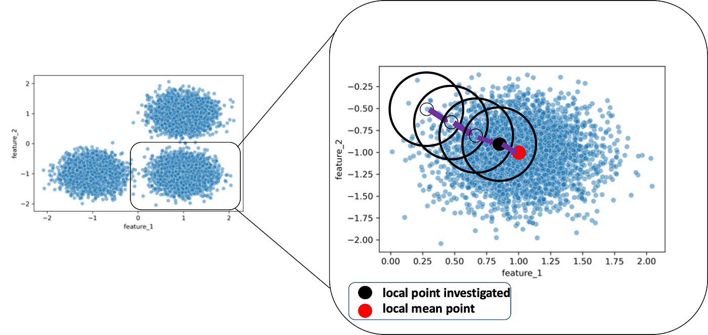
Mean-Shift
Process
Ref: Mean-Shift Clustering

Slide 8
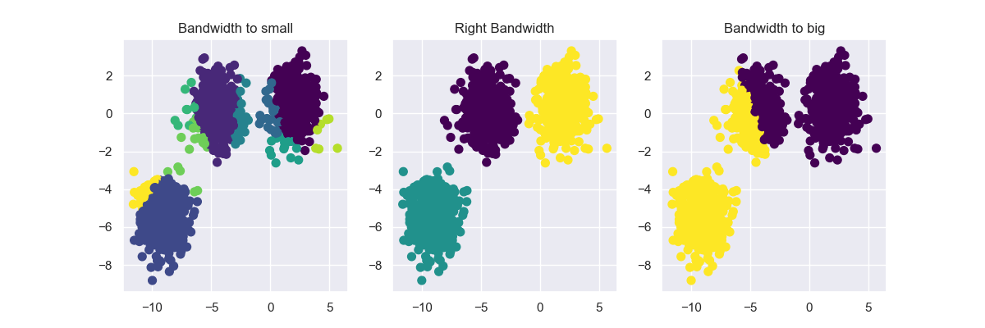
Mean-Shift
Bandwidth/Radius Selection
Ref: https://ml-explained.com/blog/mean-shift-explained

Slide 9
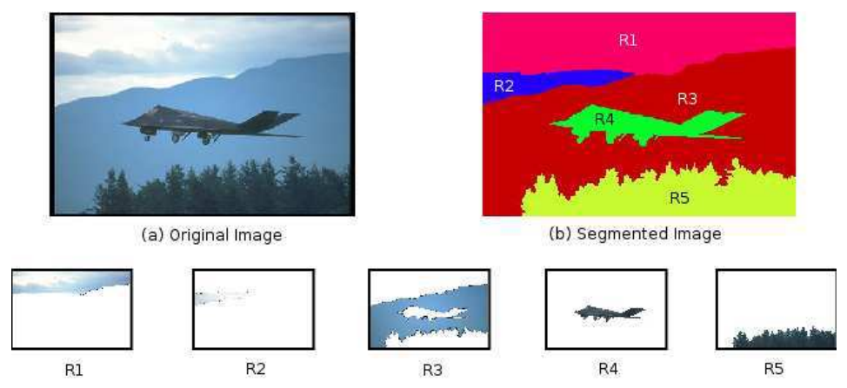
Mean-Shift
Image Segmentation
Ref: https://theses.hal.science/tel-00996067/

Slide 10
Mean-Shift
K-Means

Slide 11
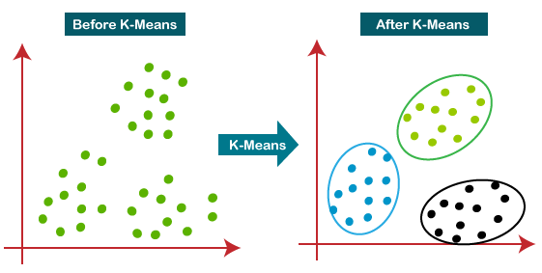
K-Means
Concept
- K-means clustering is an unsupervised machine learning algorithm used to group data points into clusters.
Ref: K-means clustering

Slide 12
K-Means
Process
- Initialization: Choosing the Number of Clusters (K).
- Initializing Centroids: K random data points are selected as initial centroids (cluster centers).
- Assignment: Each data point is assigned to the cluster with the nearest centroid.
- Update: The centroid of each cluster is recalculated as the mean of all points assigned to that cluster.
- Convergence: The assignment and update process is repeated until the cluster assignments no longer change.

Slide 13
K-Means
Process
Ref: Creating Animation to Show 4 Centroid-Based Clustering Algorithms using Python and Sklearn

Slide 14
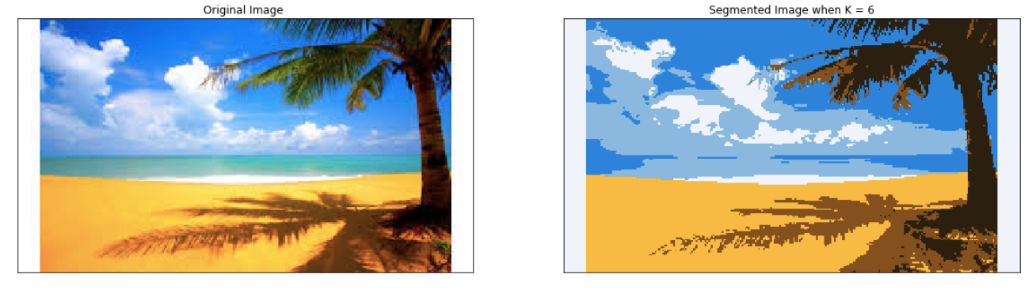
K-Means
Image Segmentation
Ref: https://github.com/Yuvrajchopra25/Project-8-Image-Segmentation-using-Sklearn-and-K-Means

Slide 15
K-Means
K-means vs Mean Shift
- Number of Clusters: K-means requires the user to specify the number of clusters (K), while Mean Shift automatically determines the number of clusters based on data density.
- Cluster Shape: K-means assumes clusters are roughly spherical or ellipsoidal, while Mean Shift can identify more complex, non-convex shapes.
- Runtime Complexity: K-means generally has a faster runtime complexity compared to Mean Shift, which can be computationally more intensive.
- Noise and Outliers: Mean Shift is generally more robust to noise and outliers because it relies on density rather than distance to centroids.

Slide 16
Mode Finding & Mean-Shift
Practice
- Mean-Shift
- K-Means

Slide 17
Thank You
anhtl@ut.edu.vn

